Slide 1


Blockchain Technology
Notes:
Why are we talking about blockchain?:
In todays world there is noting you could be certain about.
If you meet someone online how do you know they're who they say they are?
When you buy something that's labeled fair trade what makes you so certain of its origin?
To be sure really sure about any of those questions you need a system where records could be stored, facts can be verified by anyone, and security is guaranteed. That way no one could cheat the system by editing records because everyone using the system would be watching. Systems like this are on the horizon and the software that powers them it's called a blockchain.

Slide 2
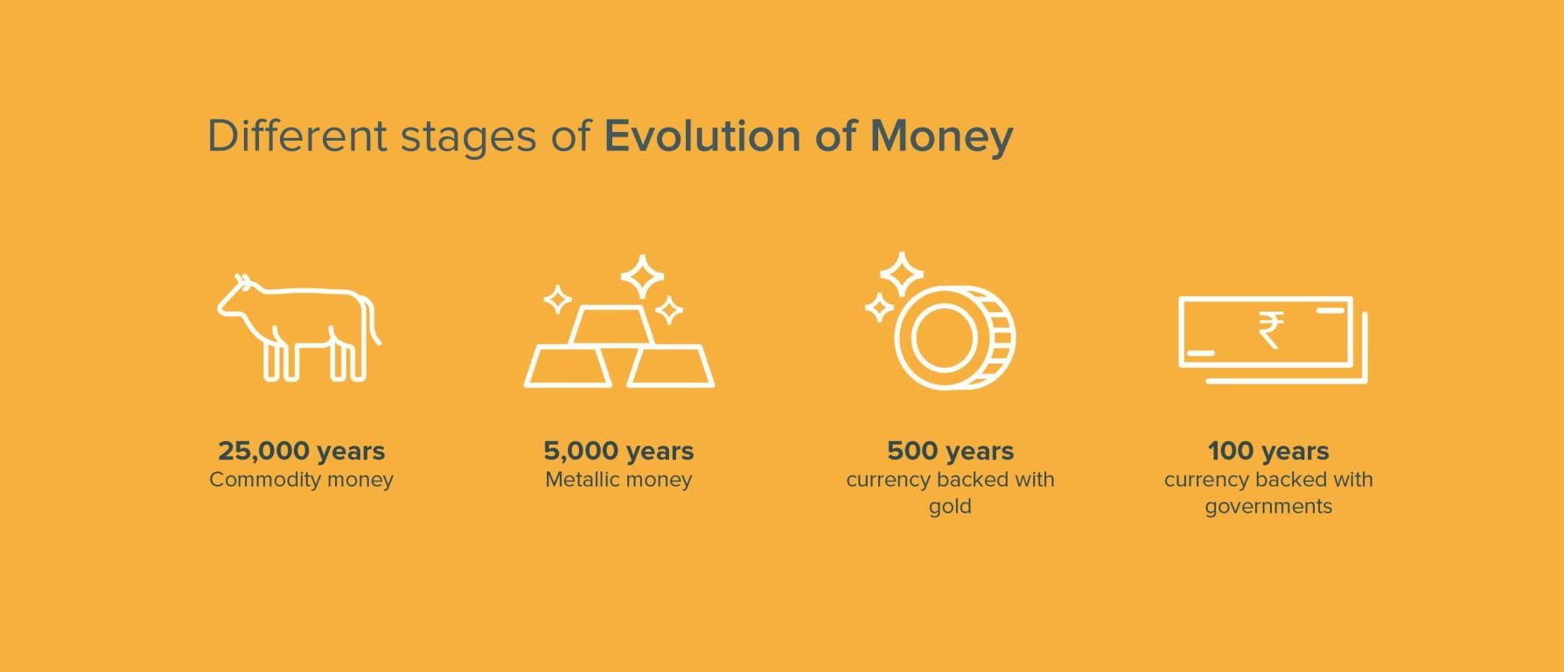

Slide 3
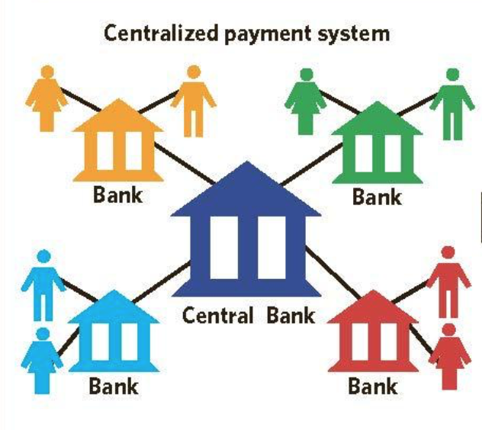
Current Banking System

Slide 4


Problems with the Current System
Processing charges
Slow and time consuming
Black box
Under control of an organization
100$
98$
John
Sam

Slide 5
What can be the Possible Solution?
We need a system which:
No middleman and intermediaries
Is transparent and secure
No control of any central authority
Hence, we need a Distributed System

Slide 6
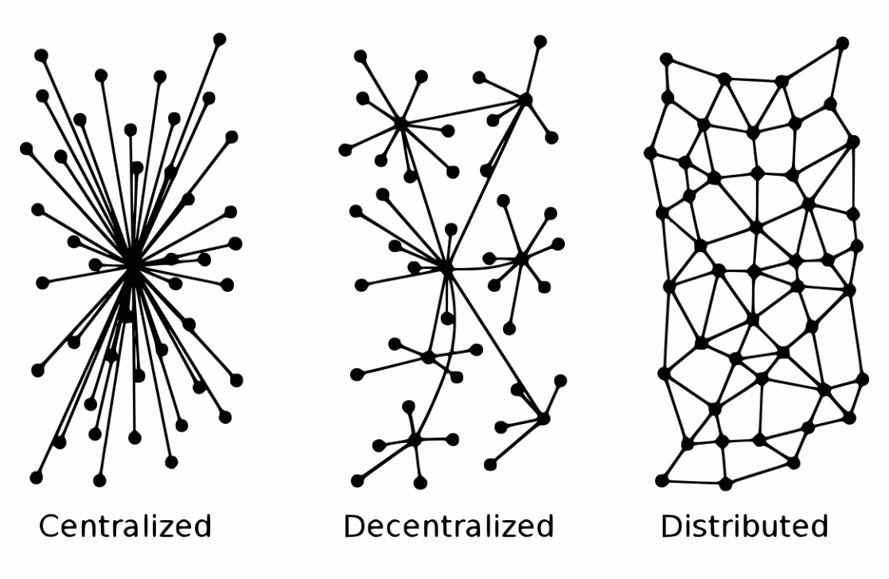
Distributed System attempts to Solve the Problem

Slide 7
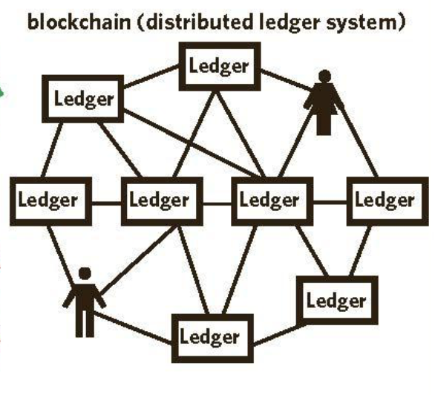
Distributed System

Slide 8
Defining Blockchain
Structure where each block is linked to another block in a time stamped chronological manner
It is a distributed digital ledger of an immutable public record of digital transactions
Every new record is validated across the distributed network before it is stored in a block
All information once stored on the ledger is verifiable and auditable but not editable
Each block is identified by its cryptographic signature
Pure distributed peer to peer system

Slide 9
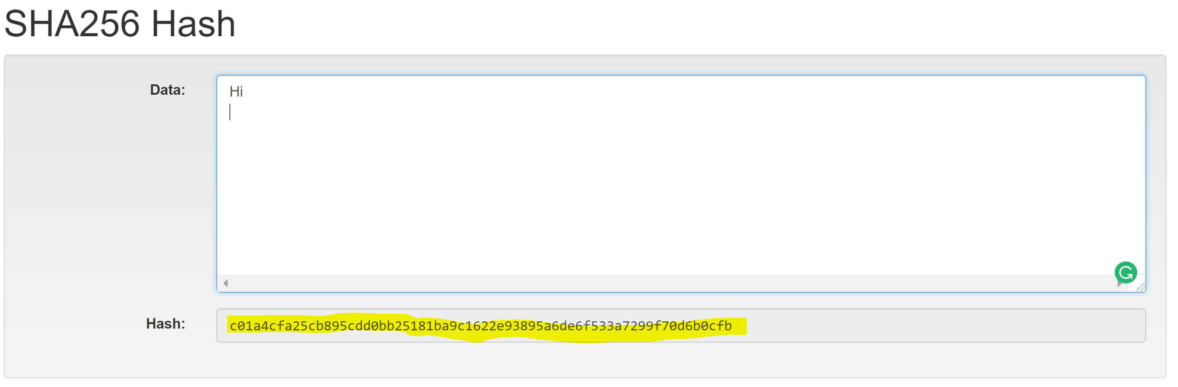
HASHING

Slide 10
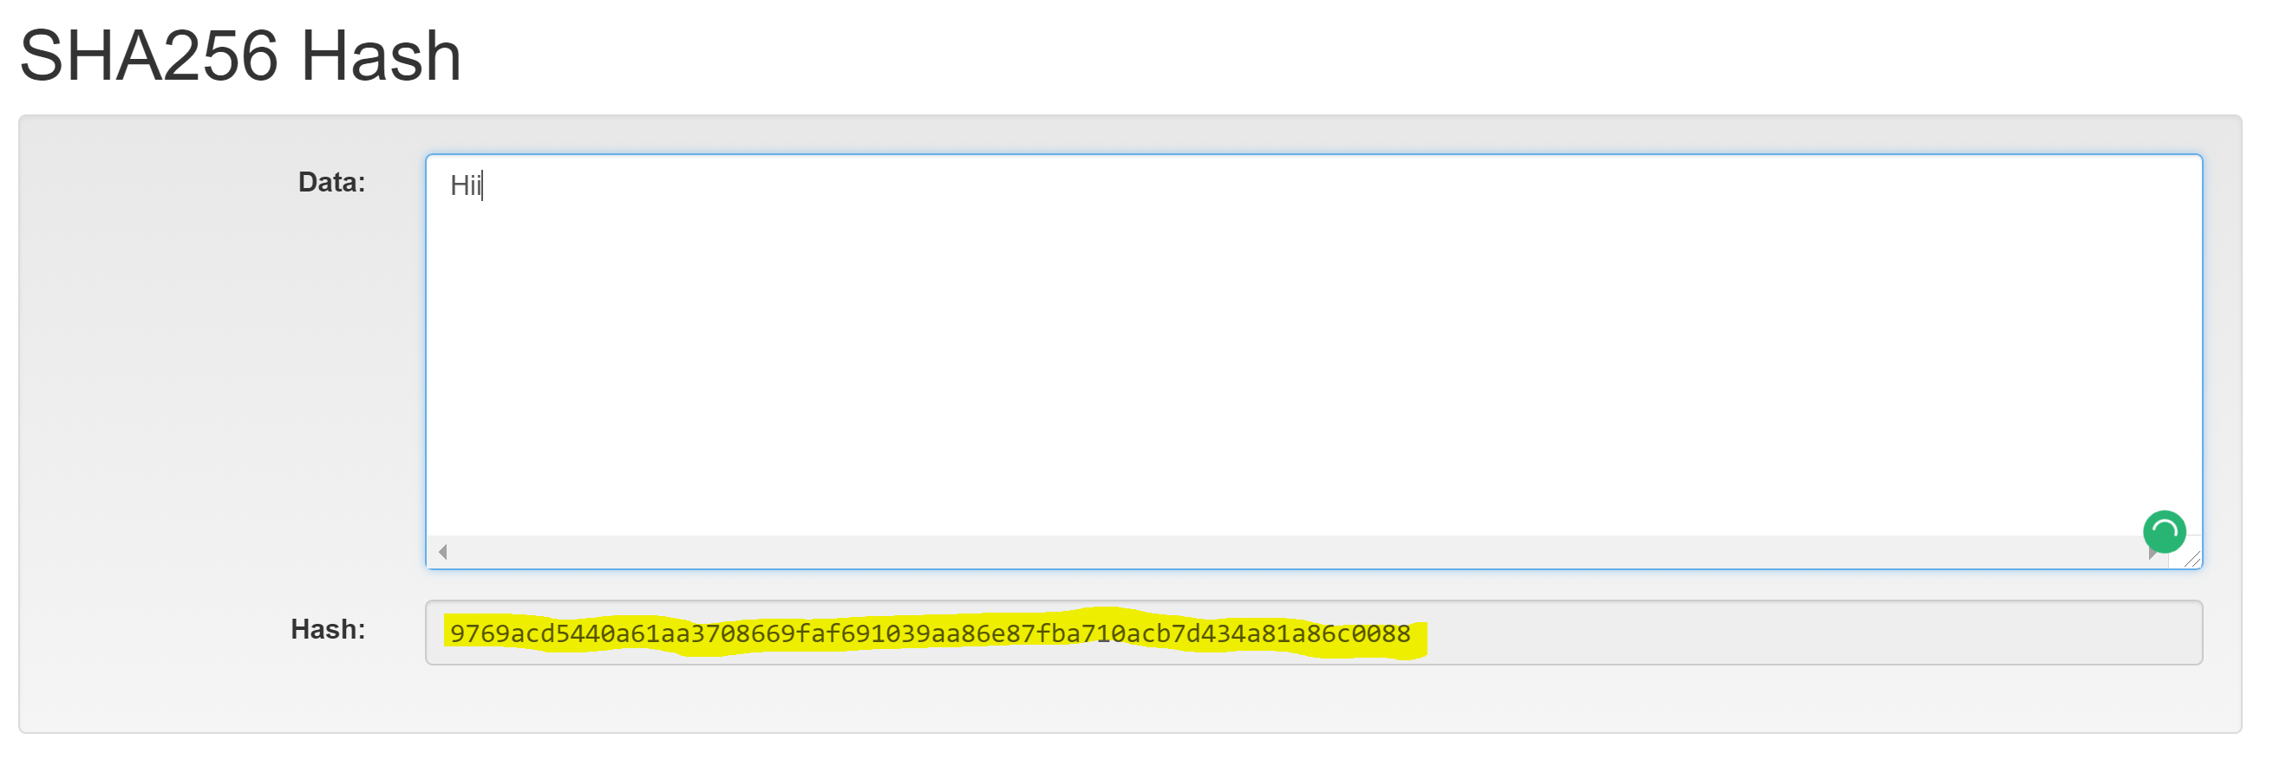
HASHING
Link:- https://anders.com/blockchain/blockchain.html

Slide 11
Accounts
Externally owned accounts
Contracts accounts
All externally owned accounts have a public and a private key
Accounts are represented using unique ID also known as public key
Public key is similar to our names. It’s the naming convention in Blockchain

Slide 12
Transactions
A transaction is transfer of value from one account to another
A transaction can only by created by holder of a private key
Private keys help in adding a digital signature or signing the transaction.
Recipients of transaction can validate the senders id using senders public id.

Slide 13
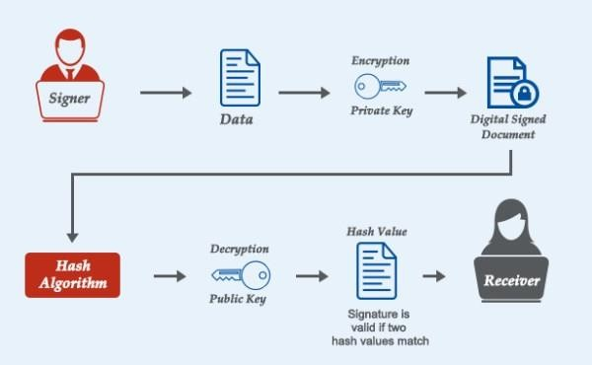
Digital Signature

Slide 14
Block
Container of transactions
Block has a fixed size decided by the platform
Number of transactions in a block is depends on this size
Blocks are written and shared in ledgers
Blocks have block header and Block body
Block body contains individual transactions
Block header contains important block information including block hash, block identifier, height, parent block and nonce.

Slide 15
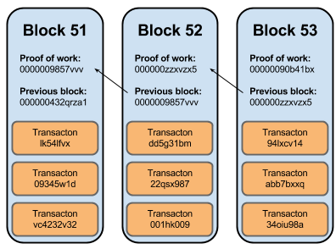

Slide 16
Miner
Miner is responsible for writing blocks in ledger
Miners are responsible for validating transaction
Miners are responsible for validating blocks in ledger
Miners are responsible for propagating blocks in network

Slide 17
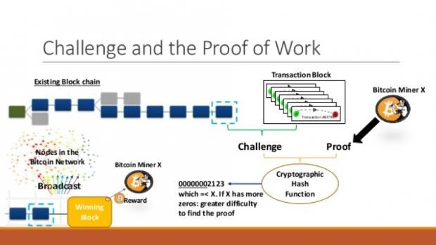
Mining
Not for distribution - Confidential

Slide 18
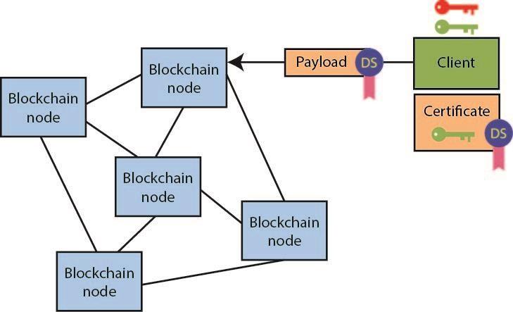

Slide 19

Transaction
Sam | Transactio | The nodes | A new | Both | The Block
wants to | n reaches | compete | block with | Accounts | is
send $$ to | the | and | transaction | are | replicated
Mark | network | validates | is | updated | and stored
 |  | the | generated |  | on all
 |  | transactio |  |  | nodes
 |  | n

Slide 20

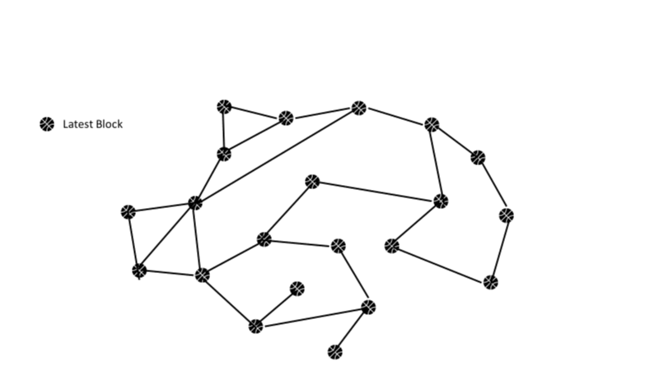

Slide 21
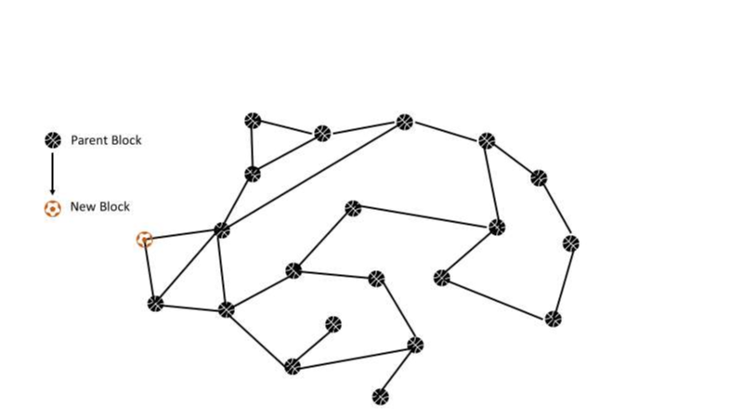

Slide 22
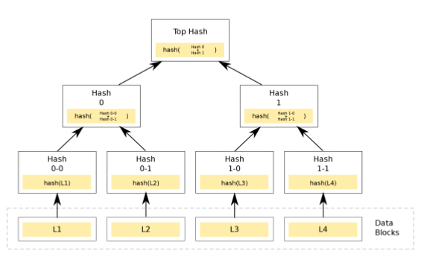

Slide 23
Functions of miner
●
Receiving tx from outside
●
Forwarding tx to neighbours
●
Independent verification of every tx
●
Independent aggregation of these tx
●
Receiving blocks from network
●
Independent verification of each block
●
Independent selection of chain with most cumulative computation
●
Maintains a pool of unconfirmed tx in tx pool, memory pool

Slide 24
How are transactions verified
●
Well formed and correct – syntax and structure
●
From and To are not empty
●
Tx size is less than block size
●
Fees is available for execution

Slide 25
Blockchain use-cases across Industries
Cryptocurrency integration with gas stations
Decentralized energy data platform
Loyalty Programs
Passenger Identity Management
Automatic Claim-Reimbursement
Energy & Resources
Manufac- turing
Govt
Real Estate
Travel
Blockchain
Healthcare
Financial Services
Direct peer-to-peer payments
Instant Cross-Border Payments
Integrated and shared KYC by Banks
Virtual Currencies
Trade Finance
Land registry
Asset transfer
Real Property Purchase
Buyer & Seller agreement
Protect medical data/history of patients
Tracing counterfeit pharmaceuticals
Automated Claim-reimbursement (using
Smart Contracts)
Population health management & monitoring
Voting Platforms
Birth and Death Certificated
Public records keeping
Time stamping of Certified Issued
Managing Govt issued IDs
Transparency and traceability in full supply chain
Supply chain cargo tracking

Slide 26
HANDS ON

Slide 27

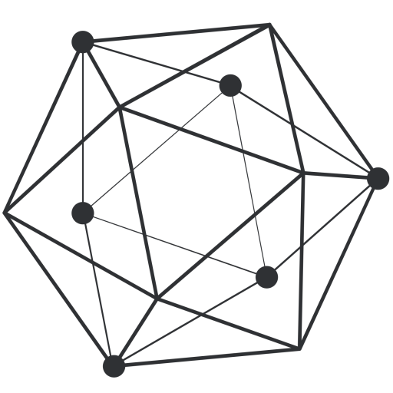
Platform for building dapps
Ethereum
Hyperledger
Notes:
Now,We will compare Ethereum and hyperledger which are most promising platforms for building dapps now a days.
It is always great to compare things to make blurred lines clear.
We will compare them on the basis of some parameters like network,cryptocurrency ,consensus etc.
Before going further to compare them ,let me tell you a little bit about both these platforms.
So to begin with ethereum,
Ethereum is a decentralised platform to write bussiness logic on the blockchain in the form of smart contracts.
These contracts are executed on a decentralised computer known as ethereum virtual machine which lies at the core of ethereum architecture.
Where as hyperledger is an opensource project under linux foundation.Hyperledger has various projects under its license like fabric,burrow,iroha,indy.
All these solutions enable developers to built blockchain solutions for industrial and bussiness related problem.
Now lets begin comparing them in next slide.

Slide 28
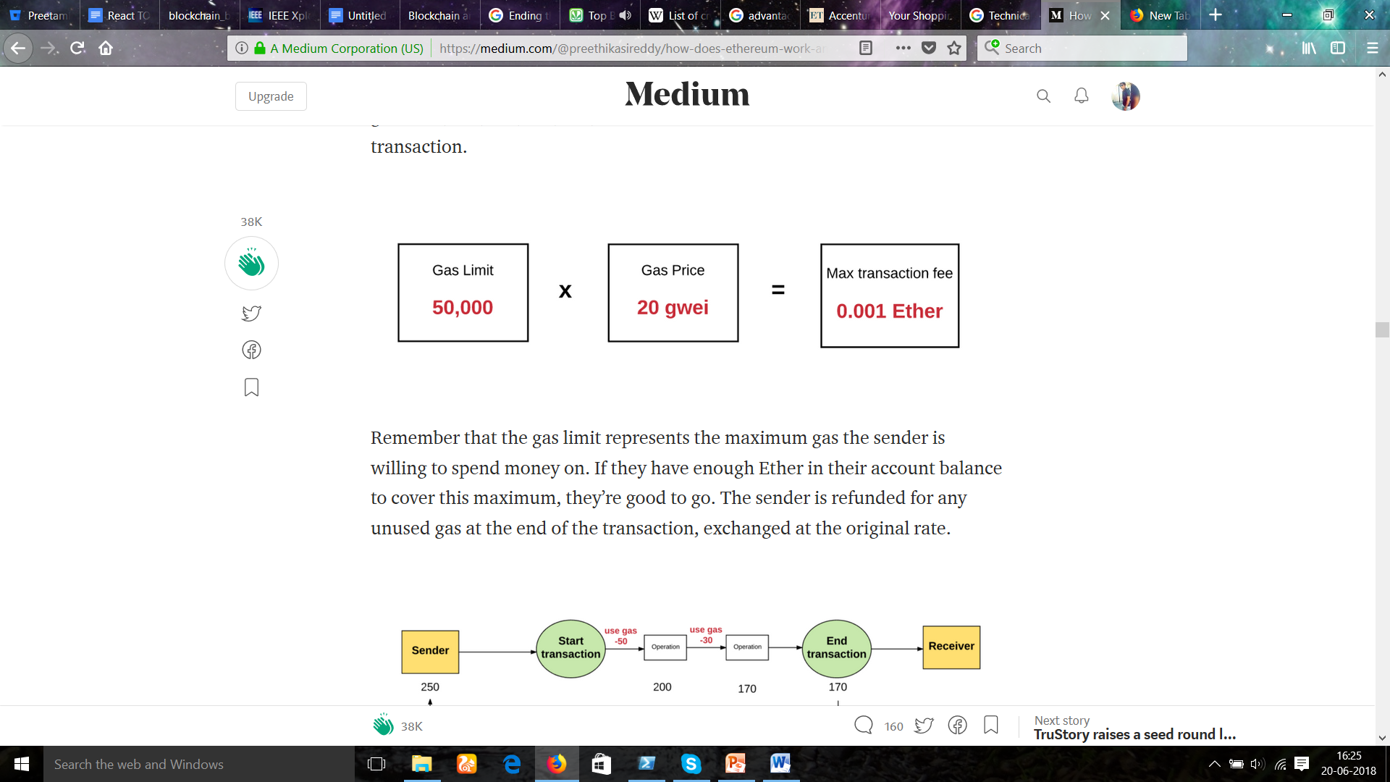
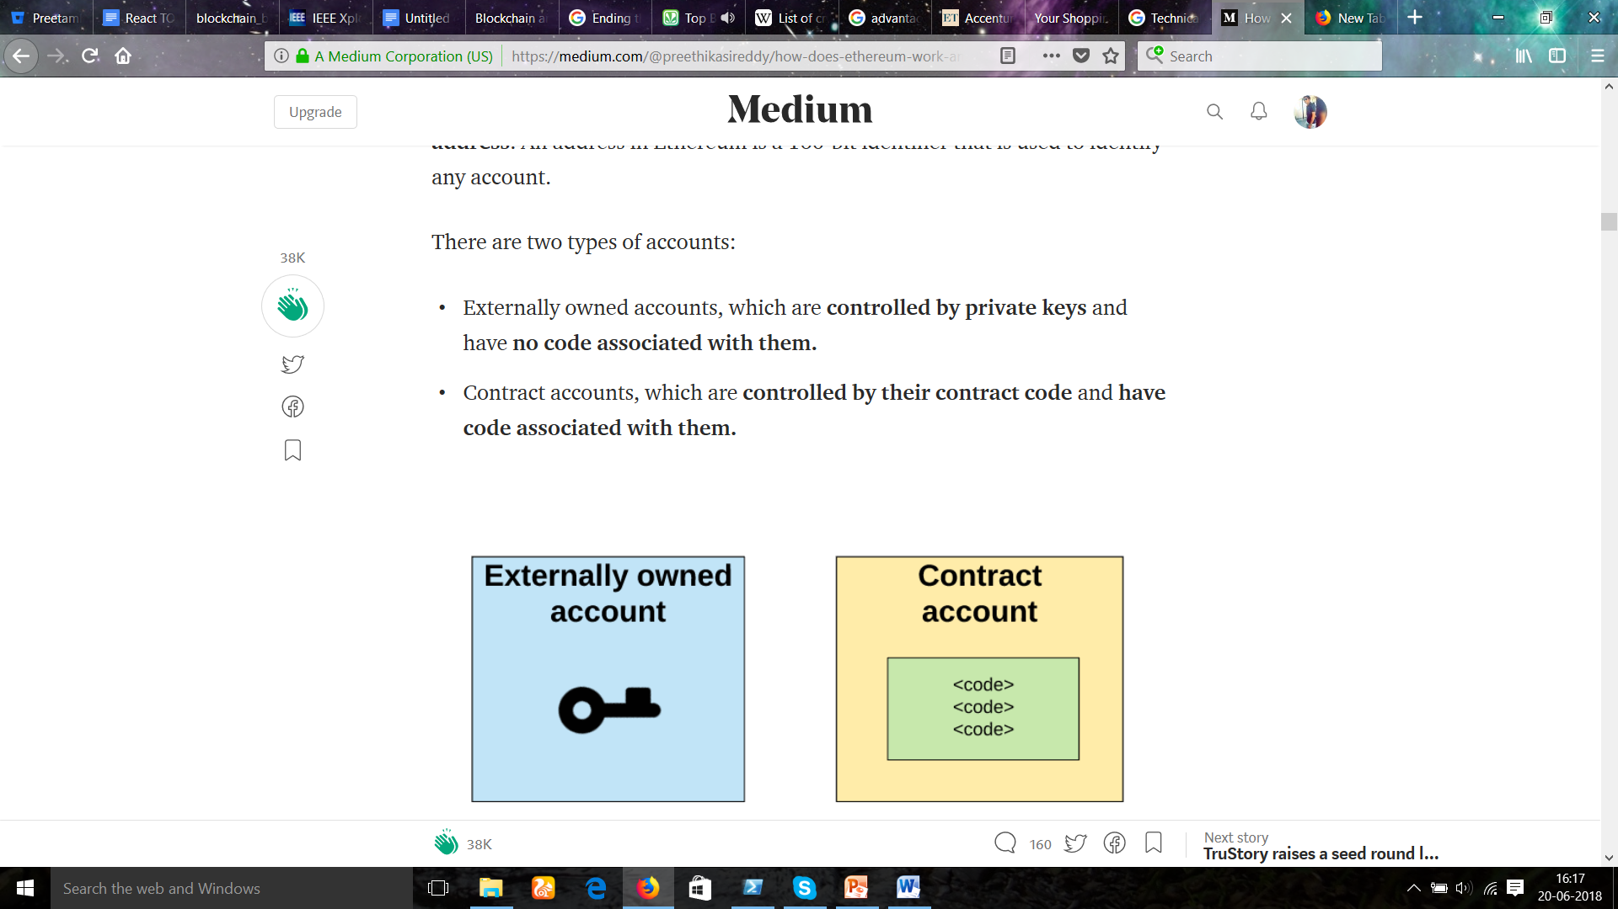
Terminologies in Ethereum
Ether
Gas
Gas price and limit
Accounts
Transaction
Notes:
Before moving to hands on session on ethereum ,we need to get the clear understanding of these terms.These terms will be used most often in ethereum development .So lets begin with:-
ETHER:- Ether is the underlying token powering the Ethereum blockchain, but it serves a slightly different purpose than bitcoin does to the Bitcoin blockchain.
Although ether is traded on public markets and has displayed price appreciation similar to bitcoin, they are quite different by design.
Ether is not intended to be a unit of currency on a peer-to-peer payment network; rather, it acts as the “fuel” or “gas” that powers the Ethereum network.
It provides the incentive for nodes to validate blocks on the Ethereum blockchain, which contains the smart contract code. Every time a block is validated, 5 ethers are created and awarded to the successful node.
GAS:- For every executed operation there is a specified cost, expressed in a number of gas units.
Every operation that a smart contract is able to take advantage of has an associated gas value.
Purpose of gas in ethereum?
The purpose of gas is to prevent execution of code that blocks network.
Ethereum implements an execution environment on the blockchain called the Ethereum Virtual Machine (EVM).
Every node participating in the network runs the EVM as part of the block verification protocol.
They go through the transactions listed in the block they are verifying and run the code as triggered by the transaction within the EVM.
Each and every full node in the network does the same calculations and stores the same values. The fact that contract executions are redundantly replicated across nodes, naturally makes them expensive, which generally creates an incentive not to use the blockchain for computation that can be done offchain.
GAS PRICE AND LIMIT:- Every transaction is required to include a gas limit and a fee that it is willing to pay per gas. Miners have the choice of including the transaction and collecting the fee or not. In reality, today all transactions are picked up by miners eventually, but the amount of transaction fees that a user chooses to send affects how long it will take until the transaction is mined.
We need to set a gas price before making the transaction.Gas price is the amount of ether the user is willing to pay per unit of gas used in transaction.Higher gas price increases the chances of transaction to be mined in less time.
Total transaction cost is the product of gas price and gas limit.
FAUCET:-
If you’d like to own some ether but don’t have enough money to purchase any or buy a mining rig, then you can use Ethereum faucet.
Faucets reward users with free Ethereum for viewing ads and completing captchas. The sites then use some of the ad revenue that they receive to continue to fund the faucet with more Ethereum.
Most of these faucets are scams .So research well before going to any faucet website.However there is one another type of faucet which gives us test ether.Test ether is not worth of any actual value but it is used to test our smart contracts. For ex: Rinkeby test faucet,Ropsten test faucet.
ACCOUNTS:- There are two types of accounts in Ethereum
Externally Owned Accounts
Contracts Accounts
Externally owned accounts
An externally controlled account
=>has an ether balance,
=> can send transactions (ether transfer or trigger contract code),
=>is controlled by private keys,
=> has no associated code.
Contract accounts
A contract
=> has an ether balance,
=> has associated code,
=> code execution is triggered by transactions or messages (calls) received from other contracts.
when executed - perform operations of arbitrary complexity manipulate its own persistent storage, i.e. can have its own permanent state - can call other contracts
TRANSACTION:- In the most basic sense, a transaction is a cryptographically signed piece of instruction that is generated by an externally owned account, serialized, and then submitted to the blockchain.
There are two types of transactions: message calls and contract creations (i.e. transactions that create new Ethereum contracts).
All transactions contain the following components, regardless of their type:
nonce: a count of the number of transactions sent by the sender.
gasPrice: the number of Wei that the sender is willing to pay per unit of gas required to execute the transaction.
gasLimit: the maximum amount of gas that the sender is willing to pay for executing this transaction. This amount is set and paid upfront, before any computation is done
.
to: the address of the recipient. In a contract-creating transaction, the contract account address does not yet exist, and so an empty value is used.
value: the amount of Wei to be transferred from the sender to the recipient. In a contract-creating transaction, this value serves as the starting balance within the newly
created contract account.
v, r, s: used to generate the signature that identifies the sender of the transaction.
init (only exists for contract-creating transactions): An EVM code fragment that is used to initialize the new contract account. init is run only once, and then is discarded.
When init is first run, it returns the body of the account code, which is the piece of code that is permanently associated with the contract account.
data (optional field that only exists for message calls): the input data (i.e. parameters) of the message call. For example, if a smart contract serves as a domain registration service, a call to that contract might expect input fields such as the domain and IP address.
Messages are the internal transactions which are triggered by one contract to call the code of other contracts.Messages are similar to transactions except to the fact that they are not triggered by external account but they can be triggered only by contract account.

Slide 29
Ethereum vs Hyperledger
Network
Cryptocurrency
Consensus
Smart contract
Language
Maintenance
Notes:
As we have discussed the three types of blockchains in previous slides.
Private ,Permissioned and public blockchains.
So all the points discussed previously are valid here because ethereum is public blockchain and hyperledger is permissioned blockchain.Still we can compare these two blockchains specifically on the following parameters:-
Network:-
In our case Ethereum is public blockchain network and hyperledger is a permissioned blockchain blockchain network.
It means that anyone using the internet can see any transaction on ethereum network where as hyperledger provides privacy up to any level for bussiness needs.
In hyperledger Only permissioned parties can make and see transactions.
Cryptocurrency:-
Talking about cryptocurrencies ,ethereum has its network specific coin called ether.Ether is used to make transactions on network and to buy gas ,which in turn is used to pay for computations occuring on EVM .
New ether are mined by miners who validates the transactions.
Hyperledger has no such specific coin.
Hyperledger provided freedom to application developers to implement blockchain technology how ever they want for the bussiness needs.
Consensus:-
Talking about consensus mechanism,Ethereum uses proof of work consensus mechanism for its consensus.
In case of hyperledger ,it is up to developers to choose consensus algorithm if they require.An algorithm known as Practical byzantine fault tolenrance is used in most of solutions. Blockchains like ripple and stellar are also using this.
The major difference in POW and PBFT is in case of POW only first node who solves the cryptographics puzzle will announce the answer and other will verify it where as in case of PBFT every node broadcast their own decision about the state of network and the majority of state will be commited to the blockchain.
So POW can be considered as lottery based mechanism and PBFT is voting based mechanism.
Smart contract:- Ethereum and hyperledger both allows bussiness logic to be implemented with aid of smart contract.
Ethereum smart contracts are written in ethereum specific scripting langauges like solidity.
In hyperledger on the other hand bussiness contracts are written in chaincode.Chaincode can be written in java,go ,node js and also python will be supported in upcoming verisons ,aside from that computation fee must be paid in the form of gas to execute smart contracts.
Maintainance:- Ethereum as a platform is maintained by ethereum developers at ethereum foundation and hyper ledger is maintained by Linux foundation so any open source contributor can contribute to improve the code.

Slide 30
Bitcoin vs Ethereum
Supply
Block Time
Block Size
Type of Addresses
Smart contracts
Hashing Algorithm
Notes:
We have discussed both Bitcoin and ethereum in previous slides lets compare them further to make things more clear.
Bitcoin and Ethereum both are public blockchains .They are fundamentally same on the concept of cryptocurrecies but ethereum provides much more flexibility in terms of using blockchain technology by writing smart contracts for various use cases.We will differentiate them on the following points:-
Supply:- Btc has a limited supply, i.e.; every 4yrs the amount of btc able to be mined will halve, until it reaches 21m. Eth on the other hand doesn’t, and the same amount will be created each year — thus as a cryptocurrency, its more inflationary.
Block Time:- Block time is the time required for a block to gets mined .Block time is 10 minutes in case of bitcoin and it is about 14-16 seconds in ethereum.So transactions are much more faster in ethereum.In bitcoin the transaction speed is 3-4 transactions per second where as in ethereum it is 14-15 transactions per second.
Block size:- Block size is the size of block which gets recorded in to blockchain.In case of bitcoin block size is fixed which is 1 mb (8 mb in case of bitcoin cash which is a fork of bitcoin, we will understand what a fork is in next slides).
The concept of block size is little bit complex in case of ethereum.
In case of ethereum block size is capped by gas limit.
Ethereum’s gas limit is somewhat similar to Bitcoin’s 1 MB limit on the size of each block, with the difference being that Ethereum’s gas limit is dynamically set by miners while Bitcoin’s block size limit is hard-coded into the protocol.
So what is a gas limit?
Block gas limits are the maximum amount of gas allowed in a block to determine how many transactions can fit into a block. For example, let’s say we have 5 transactions where each transaction has a gas limit of 10, 20, 30, 40, and 50. If the block gas limit is 100, then the first four transactions can fit in the block. Miners decide which transactions to include in a block. A different miner could try including the last 2 transactions in the block (50+40), and they only have space to include the first transaction (10). If you try to include a transaction that uses more gas than the current block gas limit, it will be rejected by the network and your Ethereum client will give you the message “Transaction exceeds block gas limit”.We will discuss these core terminologies like gas,gas price ,gas limit etc in next slide.
Type of addresses :-
There is only one address in bitcoin to hold transactions.In ethereum there are two types of address ,one address is to hold transactions which is known as account address and other is to hold code which is contract address.
Smart contracts:- Talking about smart contracts, Btc is built with a primary purpose, i.e.; exchange. It’s straight forward & you cannot do much else with it, except vary the rules around the exchange (i.e.; 2 to sign, etc). Eth on the other hand is very flexible. It’s designed to allow the creation of smart contracts, and because it’s Turing complete, it basically runs like one big virtual computer than can execute programs (i.e.; smart contracts, etc).
While bitcoin has a scripting language built in, it’s very limited in functionality with only a few dozen operations. Ethereum has a full general-purpose language integrated (known in computer-speak as Turing-complete). Programs written in this built in language are known as “smart contracts”.
Hashing:- Bitcoin’s hashing algorithm (SHA-256) can be performed efficiently with special purpose hardware, known as ASICs (application-specific integrated circuit). The Ethereum hashing algorithm (KECCAK-256) is memory intensive so it’s far more difficult to build an economical special-purpose chip for. This allows for Ethereum to have greater mining decentralization

Slide 31
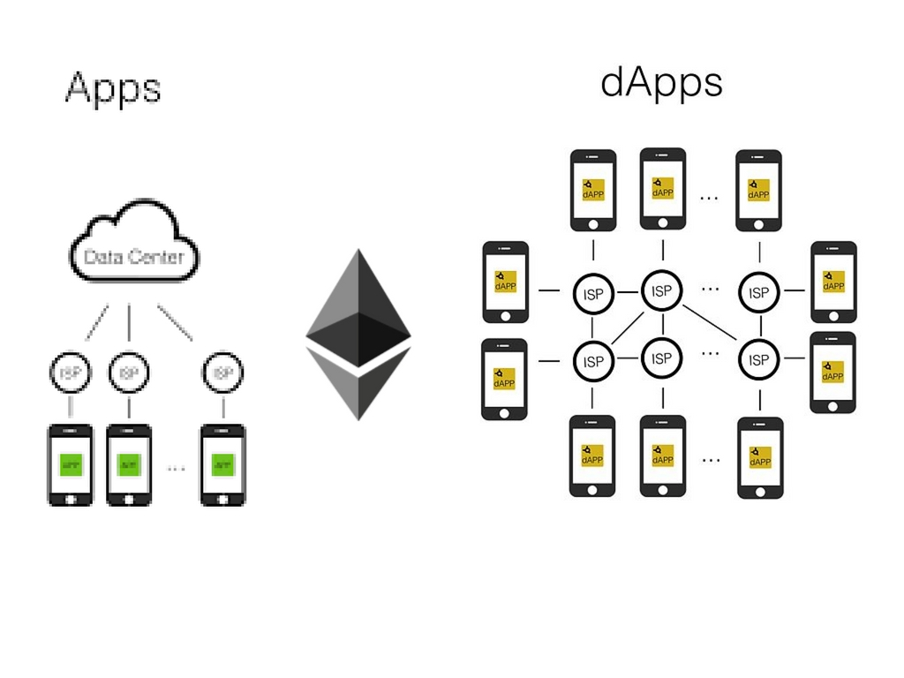



DAPPS
Notes:
Dapp:->
What are Dapps you might ask?
Imagine having your car working away, transporting passengers while you’re at work. Imagine having your computer utilizing its spare capacity to serve businesses and people across the globe. Imagine being paid for browsing the web and taking ownership of your, arguably invaluable, attention. Imagine the world like that. That world is not far away.
As the concept is still in its infancy, there might not be one definition of what a Dapp is. However, there are noticeable common features of Dapps:
Open Source. Ideally, it should be governed by autonomy and all changes must be decided by the consensus, or a majority, of its users. Its code base should be available for scrutiny.
Decentralized. All records of the application’s operation must be stored on a public and decentralized blockchain to avoid pitfalls of centralization.
Incentivized. Validators of the blockchain should be incentivized by rewarding them accordingly with cryptographic tokens.
Protocol. The application community must agree on a cryptographic algorithm to show proof of value.
Some successful ethereum based dapps are:-
GOLEM,AUGUR,BRAVE browser.

Slide 32
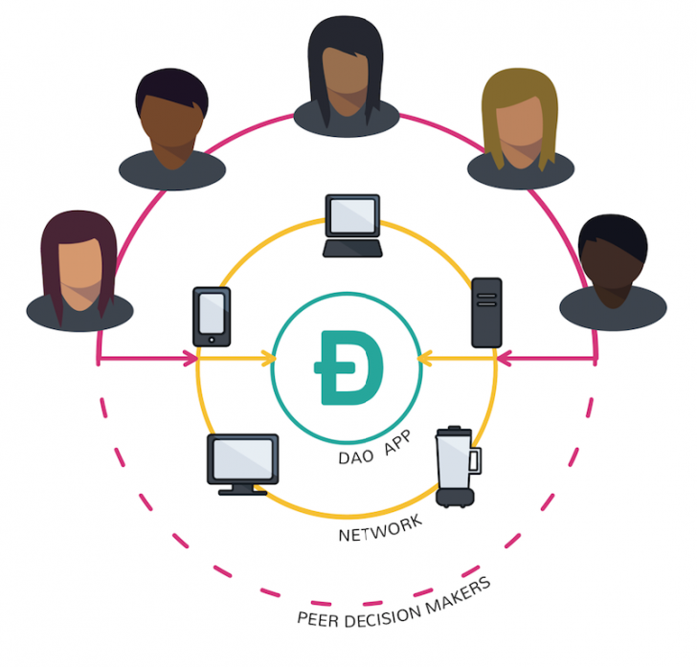

DAOS
Notes:
DAO=>
A decentralized autonomous organization, or just DAO, is a business or organization whose decisions are made electronically by a written computer code or through the vote of its members. In essence it is a system of hard coded rules that define which actions an organization will take.
For ex: Imagine a vending machine that not only takes money from you and gives you a snack in return but also uses that money to automatically re-order the goods. This machine also orders cleaning services and pays its rent all by itself. Moreover, as you put money into that machine, you and its other users have a say in what snacks it will order and how often should it be cleaned. It has no managers, all of those processes were pre-written into code.
what does a DAO need to be fully operational?
First of all, a set of rules according to which it will operate.
Those rules are encoded as a smart contract, which is essentially a computer program, that autonomously exists on the Internet, but at the same time it needs people to perform task that it can’t do by itself.
Once the rules are established, a DAO enters a funding phase.
This is a very important part for two reasons:-
Firstly, a DAO has to have some kind of an internal property, tokens that can be spent by the organization or used to reward certain activities within it.
Secondly, by investing in a DAO, users get voting rights and subsequently the ability to influence the way it operates.
After the funding period is over and a DAO is deployed, it becomes fully autonomous and completely independent from its creators as well as anyone else for that matter. They’re open source, which means their code can be viewed by anyone. Moreover, all of the rules and financial transactions are recorded in the Blockchain. This makes DAOs fully transparent, immutable and incorruptible.
Once a DAO is operational, all the decisions on where and how to spend its funds are made via reaching a consensus. Everyone who bought a stake in a DAO can make proposals regarding its future. In order to prevent the network being spammed with proposals, a monetary deposit could be required to make one.
Some successful daos:-
Steemit ,brave browser.

Slide 33





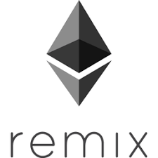
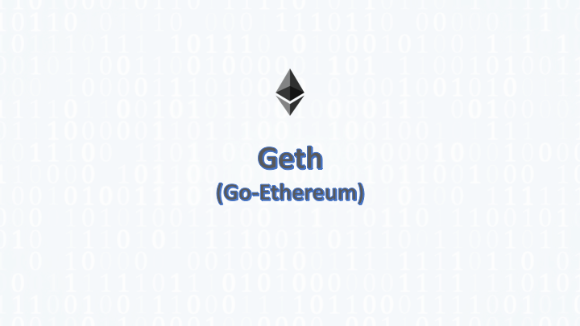

ETHEREUM ECOSYSTEM FOR BUILDING DAPPS
Notes:
The ethereum eco system consist of many tools for which are important while developing dapps.But most of them are still in infancy so can not be relied upon.
Here is a list of tools one must learn to develop a cool app on ethereum:-
Solidity:- Solidity is programming langauge similar to javascript but it is statically typed.It is specifically designed for ethereum.There are other langauges like viper and serpent but solidity is most matured So we will use it in training session.
Web3:- Web3.js is a collection of libraries which allow you to interact with a local or remote ethereum node.
Remix: Remix is an online IDE for writing ,debugging and deploying smart contracts on main network and also on test networks.It also provide and in-memory simulation of blockchain.We will see it in action in training session.
Truffle :- Truffle is a framework for quickly testing,deploying and interacting with blockchain.Truffle provides an abstraction layer for the complexities involved in smart contract development.
Ganache:- Ganache provides an in memory simulation of blockchain for smart contract development purposes.Operations on actual ethereum blockchain are asynchronous so requires arbitrary amount of time.So for development purpose we can use ganache for quickly writing,deploying and testing our contract locally in system memory.
Metamask:-Metamask is a ethereum wallet which is installed as a chrome extention .We can use metamask to create accounts ,send transactions ,receive ether and also to deploy contracts directly from remix IDE.We can also connect local network instance of ethereum node or local ethereum blockchain simulation such as ganache to metamask.
Geth :- Geth is a ethereum client.We can use geth set up our own ethereum node to start mining and also to create our ptivate network on ethereum.
While setting up a node for mining we need to download entire blockchain in our system which requires a lot of storage space.
For creating private network it is not required to download entire blockchain.
Geth allows us to mine blocks,create accounts,create transactions and view blocks history.
We will configure and set up geth private client in training session.
Infura:- Infura is a company which provides free API to connect with test and main ethereum network.So if we want to deploy our contract from local environment with out using remix browser and metamask.We can use Infura api from client side code to deploy our smart contract in to main network or test network.It requires a large storage space to set up a complete ethereum node so it is always advised to use infura.Metamask is also using infura to connect with main network.

